Slide 1
Automatic Differentiation
KAIM
Anand Krish

Slide 2
Agenda
Differentiation Strategies
Nuts & Bolts of Autodiff
Modes of Operation
Autodiff for Deep Learning
Tutorial

Slide 3


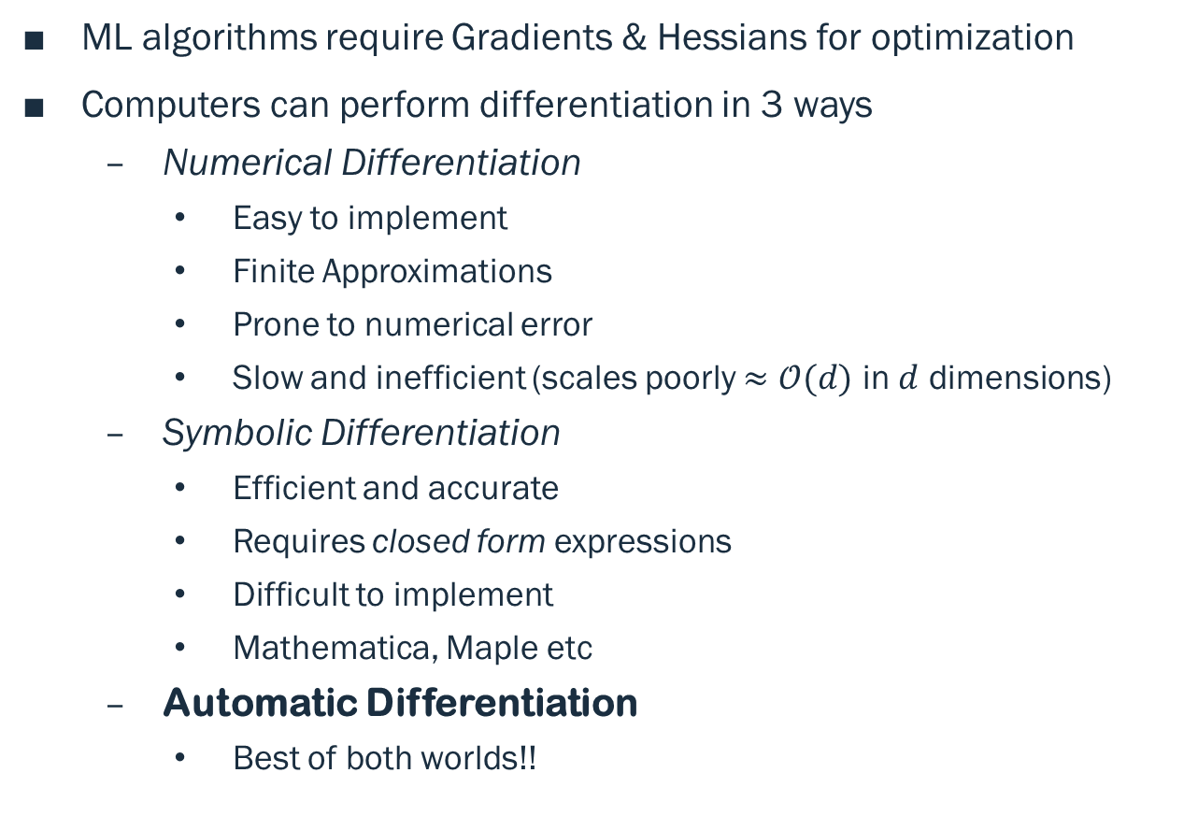
Differentiation
ML algorithms require Gradients & Hessians for optimization
Computers can perform differentiation in 3 ways
Numerical Differentiation
Easy to implement
Finite Approximations
Prone to numerical error
Slow and inefficient (scales poorly $≈𝒪(d)$ in $d$ dimensions)
Symbolic Differentiation
Efficient and accurate
Requires closed form expressions
Difficult to implement
Mathematica, Maple etc
Automatic Differentiation
Best of both worlds!!

Slide 4
Automatic Differentiation
Breakdown complex function → list of Elementary functions (Wengert List)
Use Chain Rule!
Can be applied for any computational structure –
Sequential, recursive, branched or iterative
These does not alter the numeric values
Represented as a computation graph
Which elementary functions?
Transcendental functions (exp, log, trigonometric)
Arithmetic
Requires pre-computed derivatives of elementary functions
Nothing “Automatic” in autodiff – Algorithmic Differentiation is more proper.

Slide 5









Computation Graph
Computation graph of $f\left(x_{1},x_{2}\right)=\log\left(x_{1}\right)+x_{1}x_{2}−sin⁡(x_{2})$
Backprop rule - ${\dot{v}}_{i}={\dot{v}}_{i}+{\dot{v}}_{\left\{i+1\right\}}\frac{∂v_{\left\{i+1\right\}}}{∂v_{i}}$
Intermediate Variables
$$v_{1}=\log\left(x_{1}\right)$$
$$v_{2}=x_{1}x_{2}$$
$$v_{3}=\sin\left(x_{2}\right)$$
$$v_{4}=v_{1}+v_{2}$$
$${f= v}_{5}=v_{4}−v_{3}$$
$$x_{1}$$
$$v_{1}$$
$$v_{4}$$
$$v_{2}$$
$$v_{5}$$
$$x_{2}$$
$$v_{3}$$

Slide 6
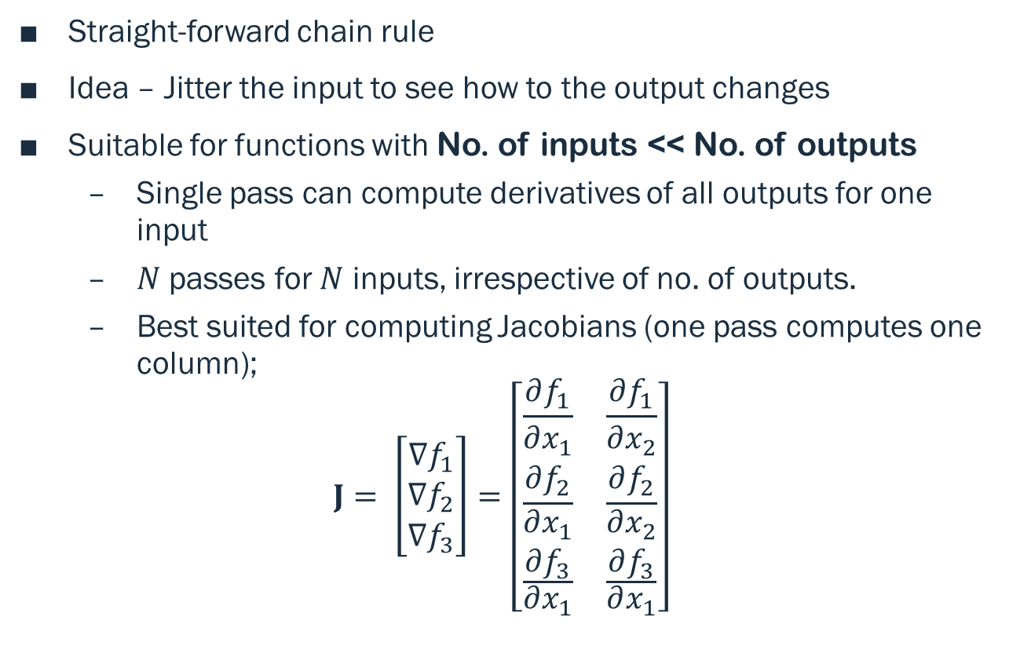
Forward Accumulation Mode
Straight-forward chain rule
Idea – Jitter the input to see how to the output changes
Suitable for functions with No. of inputs << No. of outputs
Single pass can compute derivatives of all outputs for one input
$N$ passes for $N$ inputs, irrespective of no. of outputs.
Best suited for computing Jacobians (one pass computes one column);
$$J= \left[\begin{aligned}∇f_{1} \\ ∇f_{2} \\ ∇f_{3}\end{aligned}\right]=\left[\begin{matrix}\frac{∂f_{1}}{∂x_{1}} & \frac{∂f_{1}}{∂x_{2}} \\ \frac{∂f_{2}}{\begin{aligned}∂x_{1} \\ \frac{∂f_{3}}{∂x_{1}}\end{aligned}} & \frac{∂f_{2}}{\begin{aligned}∂x_{2} \\ \frac{∂f_{3}}{∂x_{1}}\end{aligned}}\end{matrix}\right]$$

Slide 7
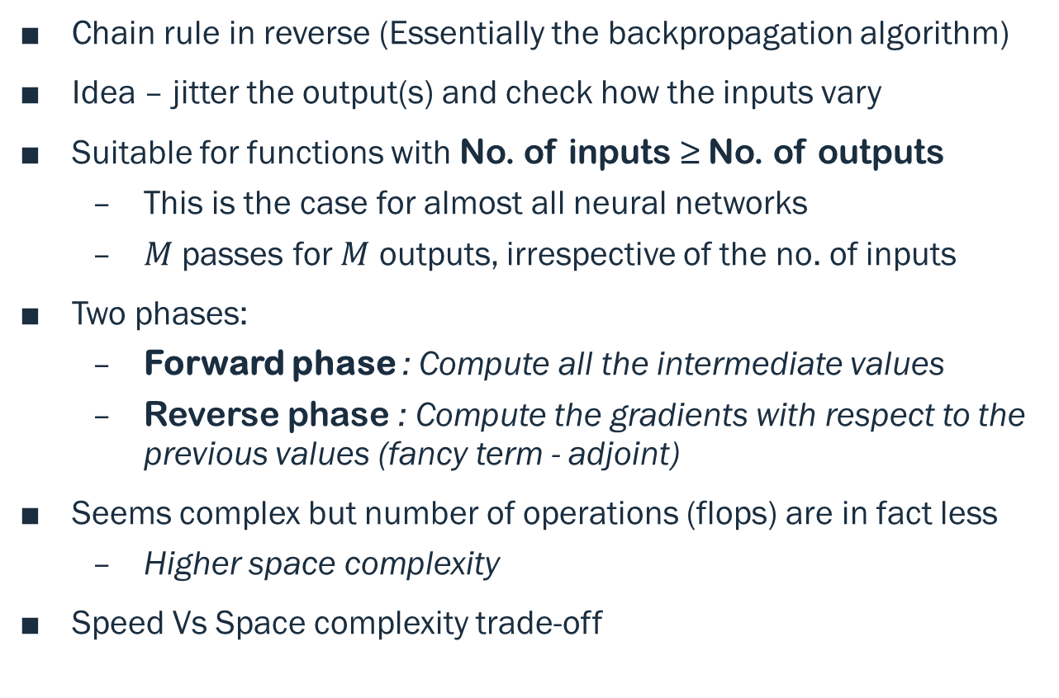
Reverse Accumulation Mode
Chain rule in reverse (Essentially the backpropagation algorithm)
Idea – jitter the output(s) and check how the inputs vary
Suitable for functions with No. of inputs ≥ No. of outputs
This is the case for almost all neural networks
$M$ passes for $M$ outputs, irrespective of the no. of inputs
Two phases:
Forward phase : Compute all the intermediate values
Reverse phase : Compute the gradients with respect to the previous values (fancy term - adjoint)
Seems complex but number of operations (flops) are in fact less
Higher space complexity
Speed Vs Space complexity trade-off

Slide 8
Autograd Package
Developed by HIPS Group, Harvard University
The following operations are done dynamically –
Decompose a complex function into a compound list of elementary functions
Construct Computation graphs
Derivatives of complex functions
Fourier transforms, logsumexp, tensor operations etc.
Pytorch and Chainer extends the functionality through -
In-place computations (no additional memory)
Require only the subset of computation graph
Enables multi-threading

Slide 9
Question Time

